Slide 1

Customer Shopping Behavior Analysis
Uncovering insights from 3,900 purchases to guide strategic business decisions

Slide 2

OVERVIEW
Project Scope
Dataset Size
Focus Areas
3,900 transactions analyzed
Spending patterns, customer segments, product preferences, subscription behavior
18 key features tracked
Methodology
Python for data prep, SQL for analysis, Power BI for visualization

Slide 3


DATA
Dataset Overview
Key Features Tracked
3.9K
Customer demographics: Age, Gender, Location, Subscription Status
Purchase details: Item, Category, Amount, Season, Size, Color
Total Rows
Shopping behavior: Discounts, Promo Codes, Previous Purchases, Review Ratings, Shipping Type
18
Missing Data: 37 values in Review Rating column (handled via median imputation)
Columns
50
Locations

Slide 4
PYTHON
Data Preparation & Cleaning
01
02
03
Data Loading
Missing Data Handling
Feature Engineering
Imported dataset using pandas, explored structure with .info() and .describe()
Imputed Review Rating nulls using median rating per product category
Created age_group bins and purchase_frequency_days columns
04
05
Data Consistency
Database Integration
Standardized columns to snake_case, dropped redundant promo_code_used field
Connected to PostgreSQL and loaded cleaned DataFrame for SQL analysis

Slide 5
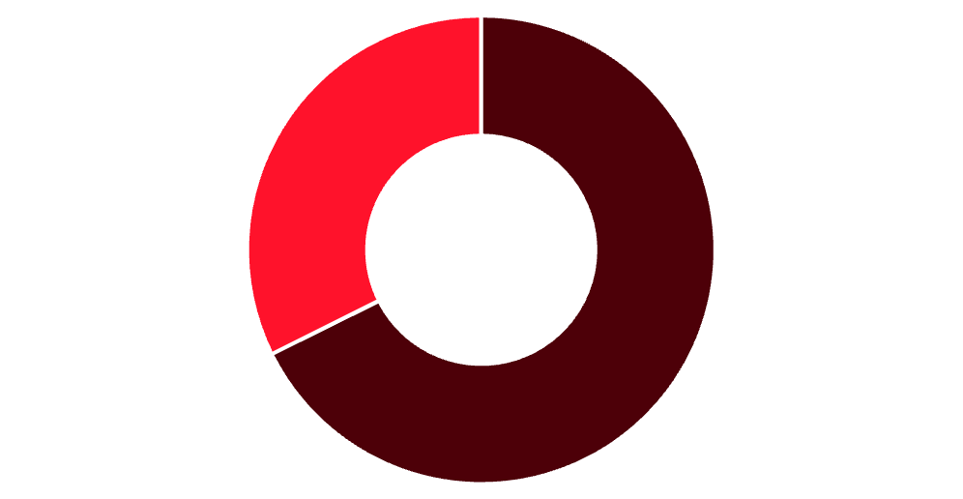


SQL ANALYSIS
Revenue & Customer Insights
Revenue by Gender
Subscription Status
27%
Male
Female
Subscribers
Male customers generate 68% of total revenue
1,053 customers
73%
Non-Subscribers
2,847 customers
Subscribers avg spend: $59.49
Non-subscribers avg spend: $59.87

Slide 6

PRODUCTS
Top-Rated Products & Discount Trends
1
2
3
Gloves
Sandals
Boots
Rating: 3.86
Rating: 3.84
Rating: 3.82
4
5
Hat
Skirt
Rating: 3.80
Rating: 3.78
Discount-Dependent Products
Hat (50%), Sneakers (49.66%), Coat (49.07%), Sweater (48.17%), Pants (47.37%)

Slide 7




SEGMENTATION
Customer Segments
Returning
701 customers
2-5 purchases
Loyal
3,116 customers
Multiple repeat purchases
New
83 customers
First-time buyers
Repeat Buyers & Subscriptions
Customers with 5+ purchases:
958 are subscribers
2,518 are non-subscribers

Slide 8
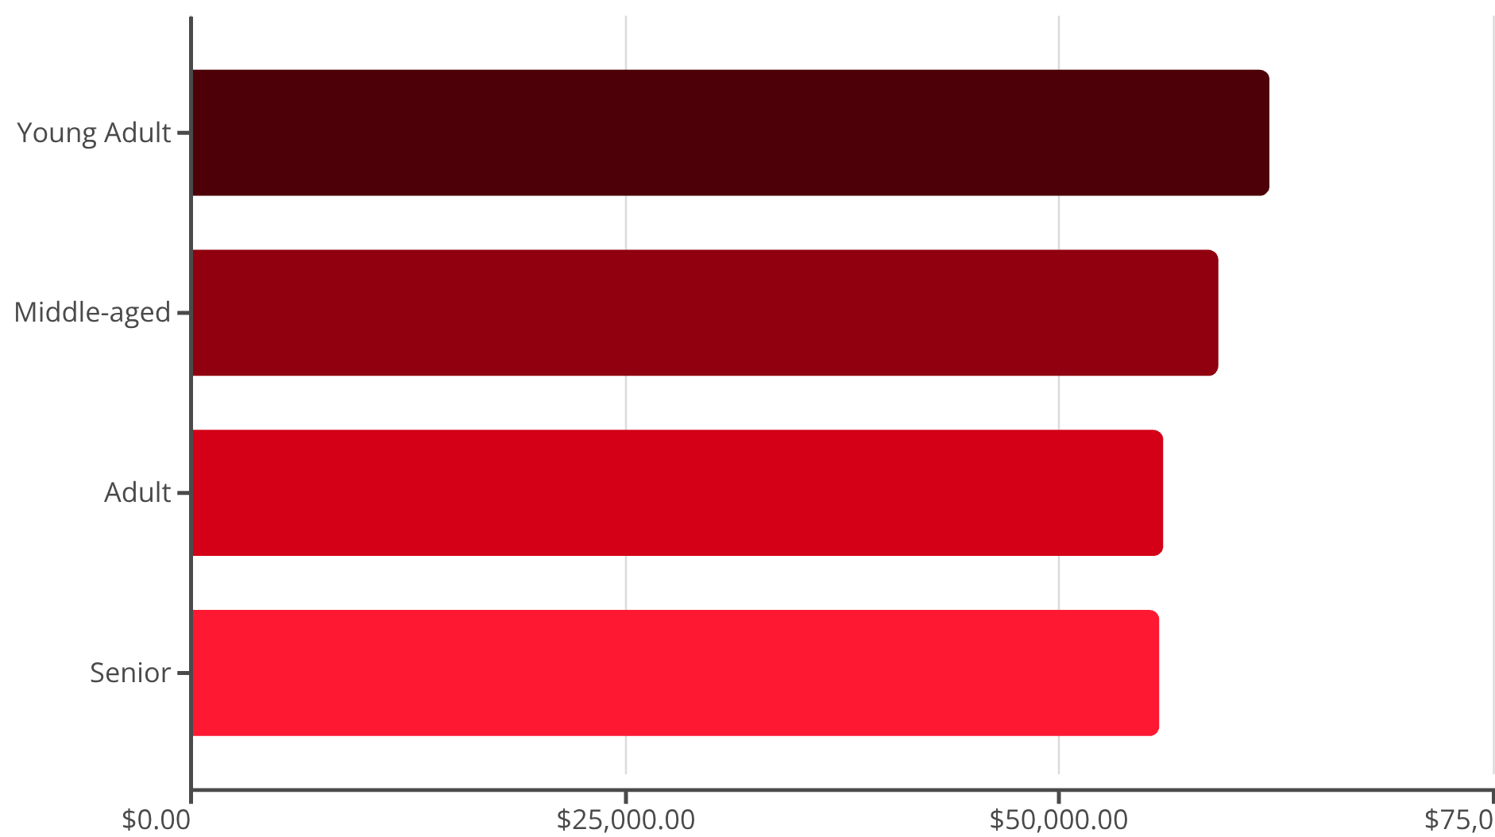
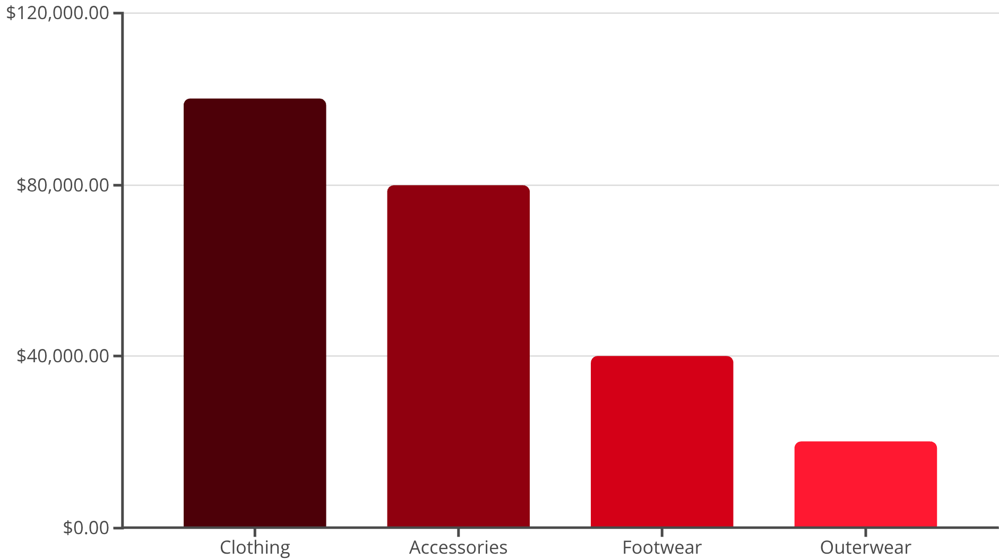
REVENUE ANALYSIS
Revenue by Age Group & Category
Revenue by Category

Slide 9
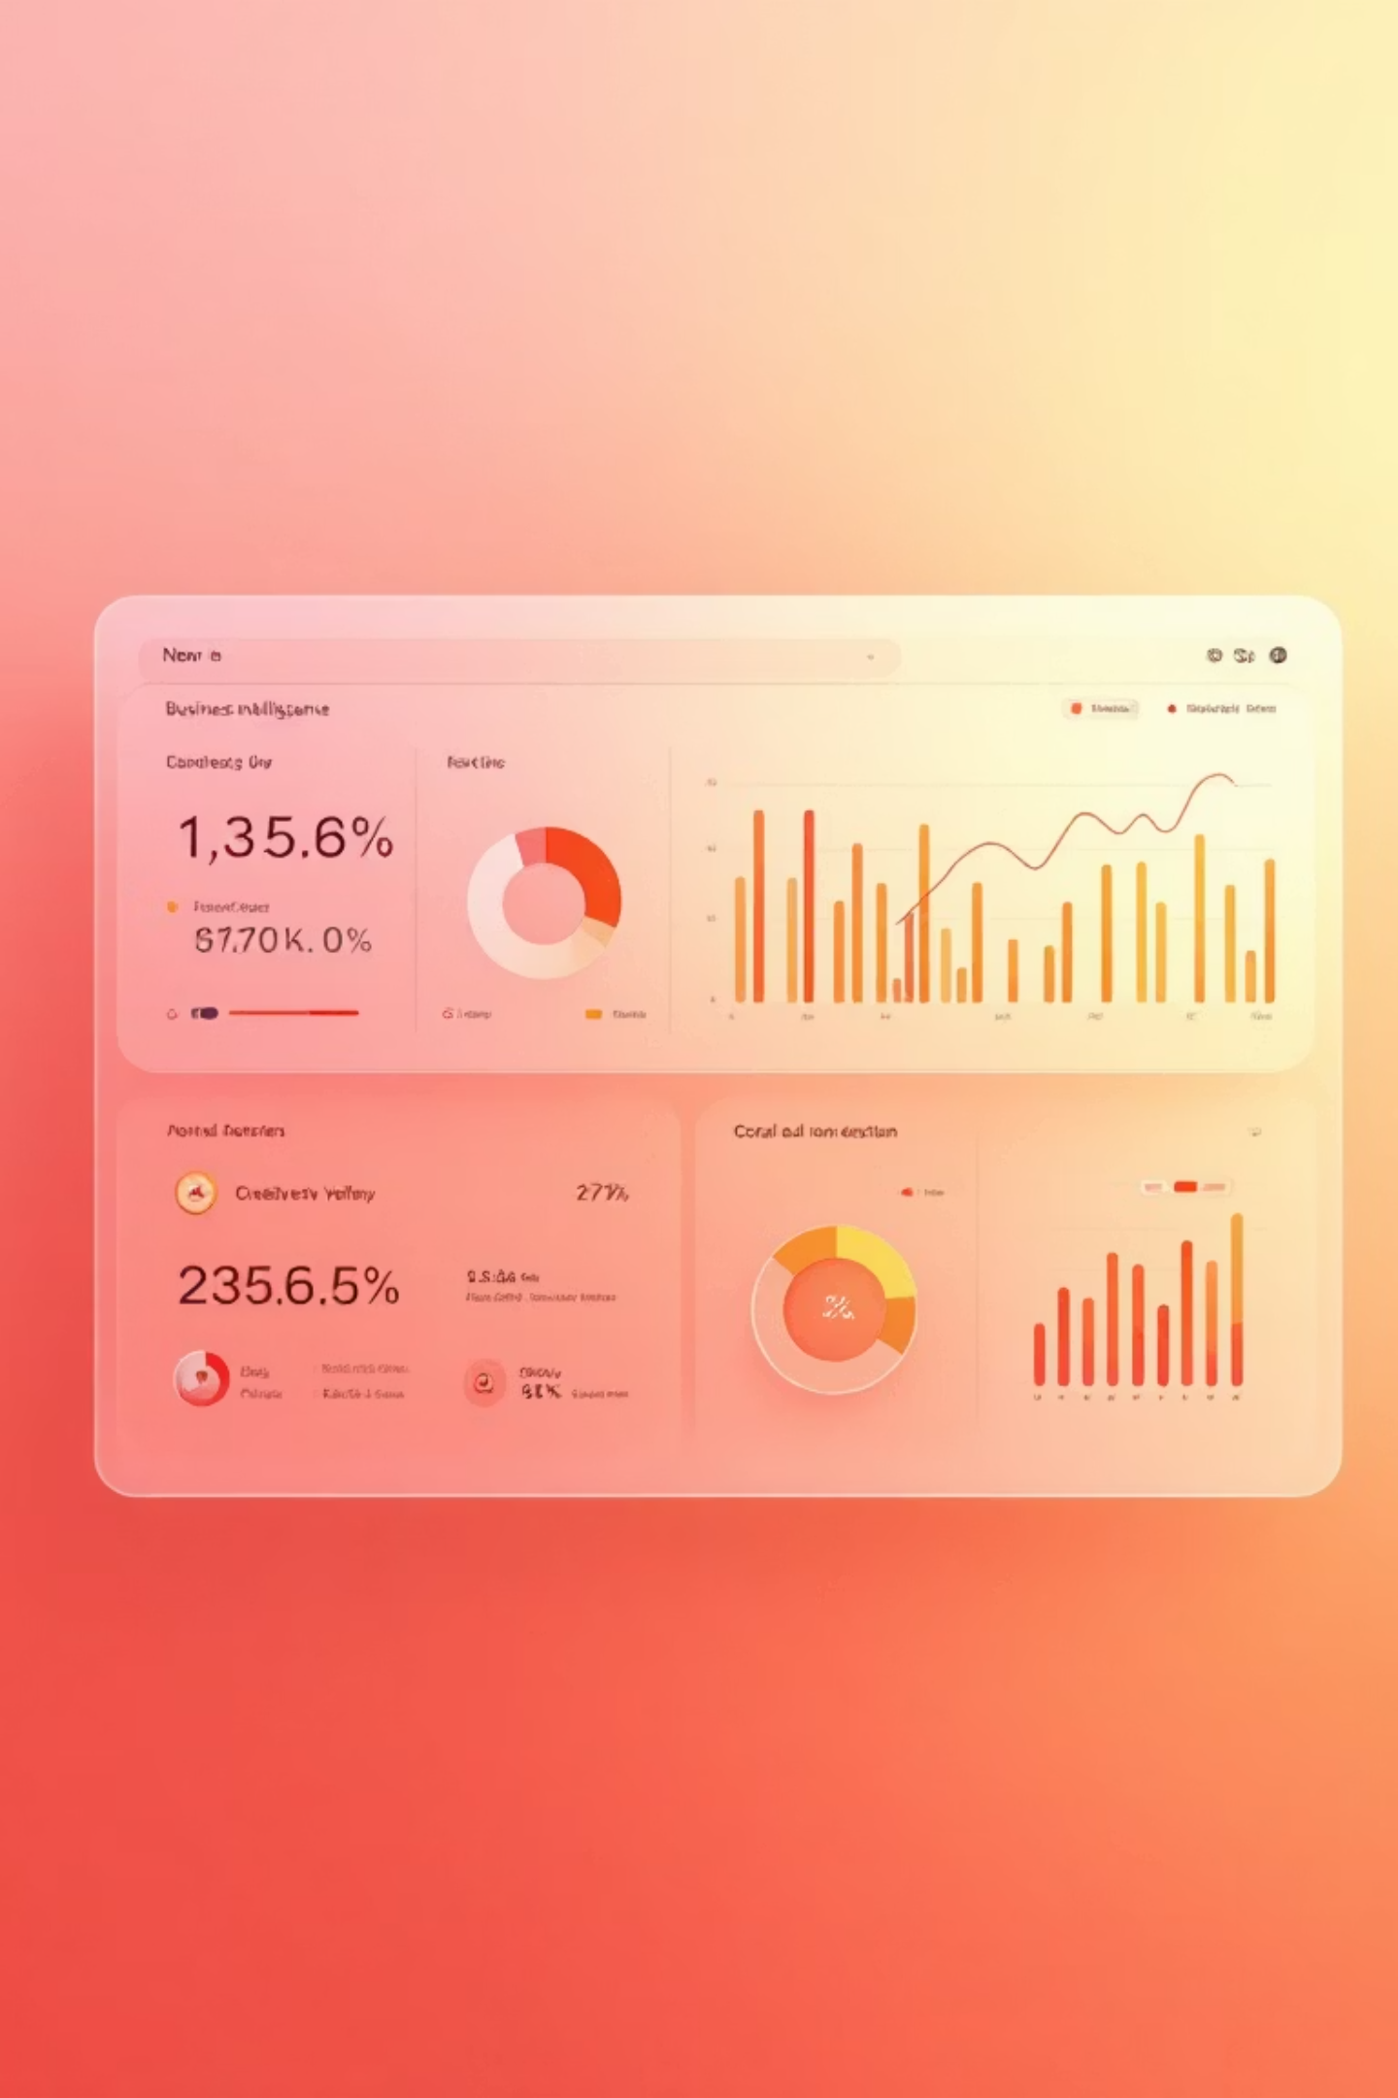
DASHBOARD
Power BI Dashboard Highlights
3.9K
$59.76
3.75
Customers
Avg Purchase
Avg Rating
Interactive filters: Subscription Status, Gender, Category, Shipping Type
Key visualizations: Revenue by category, sales by age group, subscription distribution

Slide 10





RECOMMENDATIONS
Strategic Business Recommendations
Boost Subscriptions
Loyalty Programs
Review Discount Policy
Promote exclusive benefits to convert 73% non-subscribers
Reward repeat buyers to grow loyal segment beyond 3,116 customers
Balance sales boosts with margin control for 50% discount-dependent products
Product Positioning
Targeted Marketing
Highlight top-rated items (Gloves, Sandals, Boots) in campaigns
Focus on Young Adults ($62K revenue) and express-shipping users

